Slide 1
Chapter 8 Lists

Slide 2
Lists
A list is an ordered set of values, where each value is identified by an index.
The values that make up a list are called its elements.
Lists and strings are called sequences.
Lists are similar to strings, except that the elements of a list can have any type.

Slide 3




List Values
The simplest way to create a new list is to enclose the elements in square brackets ([ and ]):
A list within another list is said to be nested.
The range function takes two arguments and returns a list that contains all the integers from the first to the second, including the first but not including the second!
With a single argument, range function creates a list that starts at 0:
If there is a third argument, it specifies the space between successive values, which is called the step size.
Empty list is a special list that contains no elements. It is denoted [].

Slide 4
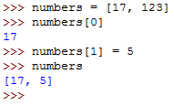
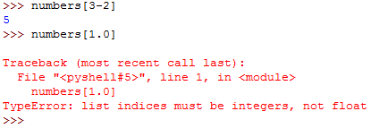
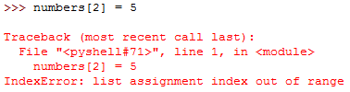

Accessing Elements
The syntax for accessing the elements of a list is the same as the syntax for accessing the characters of a string—the bracket operator ([]).
The expression inside the brackets specifies the index. Any integer expression can be used as an index.
If you try to read or write an element that does not exist, you get a runtime error:
Loop variable used as list index:

Slide 5

List Length
The function len returns the length of a list. We can use it as the upper bound of a loop instead of a constant.
Although a list can contain another list, the nested list still counts as a single element.
Write a loop that traverses the previous list and prints the length of each element.

Slide 6
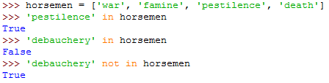
List Membership
in is a boolean operator that tests membership in a sequence such as strings and lists.

Slide 7



Lists and For Loops
The generalized syntax of a for loop is: for VARIABLE in LIST: BODY
This statement is equivalent to: i = 0 while i < len(LIST): VARIABLE = LIST[i] BODY i = i + 1
Any list expression can be used in a for loop:

Slide 8



List Operations
The + operator concatenates lists:
Similarly, the * operator repeats a list a given number of times:

Slide 9
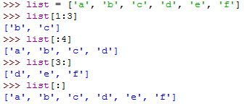
List Slices
The slice operations also work on lists:

Slide 10



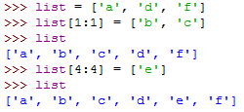
Lists are Mutable
Unlike strings, lists are mutable, which means we can change their elements.
Using the slice operator, we can update several elements at once:
or remove elements from a list by assigning the empty list to them:
Add elements to a list by squeezing them into an empty slice at the desired location:

Slide 11


List Deletion
Using del is another way to remove an element from a list:
We can use negative integers or a slice as an index for del:

Slide 12


Objects and Values
An object is something a variable can refer to.
Every object has a unique identifier, which we can obtain with the id function. By printing the identifier of a and b, we can tell whether they refer to the same object.
Lists behave differently. When we create two lists, we get two objects:

Slide 13

Aliasing
When the same list has two different names, a and b, it is aliased. Changes made with one alias affect the other:
Although this behavior can be useful, it is sometimes unexpected or undesirable. In general, it is safer to avoid aliasing when you are working with mutable objects.

Slide 14


Cloning Lists
We can make a copy of a list, clone it, using the slice operator. Taking any slice of a list creates a new list.
Any changes on the cloned list don’t affect the original one

Slide 15

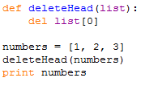
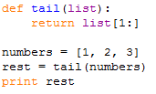
List Parameters
Passing a list as an argument actually passes a reference to the list, not a copy of the list. The parameter list and the variable numbers are aliases for the same object.
If a function modifies a list parameter, the caller sees the change.
If a function returns a list, it returns a reference to the list. Because the return value was created with the slice operator, it is a new list.

Slide 16
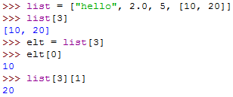
Nested Lists
A nested list is a list that appears as an element in another list.
Bracket operators evaluate from left to right.

Slide 17

Matrices
Nested lists are often used to represent matrices. matrix variable is a list with three elements, where each element is a row of the matrix.
We can select an entire row from the matrix using the index or we can extract a single element from the matrix using the double-index form. The first index selects the row, and the second index selects the column.

Slide 18




Strings and Lists
The split function in the string module breaks a string into a list of words. By default, any number of whitespace characters is considered a word boundary:
An optional argument called a delimiter can be used to specify which characters to use as word boundaries.
The join function is the inverse of split. It takes a list of strings and concatenates the elements with a space between each pair:
join function also takes an optional delimiter that is inserted between elements:

Slide 19




List Methods
Python provides methods that operate on lists. append method adds a new element to the end of a list:
extend takes a list as an argument and appends all of the elements:
sort arranges the elements of the list from low to high:
List methods are all void; they modify the list and return None.

Slide 20
Chapter 9 Tuples

Slide 21




Mutability and Tuples
Compound types:
strings, made up of characters, immutable
lists, made up of elements of any type, mutable
tuples, similar to lists, immutable.
Syntactically, a tuple is a comma-separated list of values. Although it is not necessary, it is conventional to enclose tuples in parentheses:
To create a tuple with a single element, we have to include the final comma:
Without the comma, Python treats (’a’) as a string in parentheses:
Operations on tuples are the same as the operations on lists.

Slide 22


Mutability and Tuples Cont.
If we try to modify one of the elements of the tuple, we get an error:
Even if we can’t modify the elements of a tuple, we can replace it with a different tuple:

Slide 23

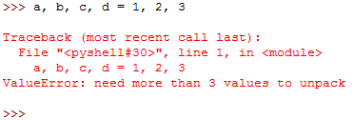
Tuple Assignment
Example of tuple assignment:
The left side is a tuple of variables; the right side is a tuple of values.
Each value is assigned to its respective variable.
All the expressions on the right side are evaluated before any of the assignments.
The number of variables on the left and the number of values on the right have to be the same:

Slide 24
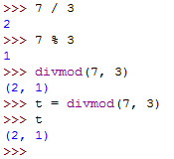

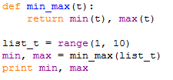
Tuples as return values
Strictly speaking, a function can only return one value, but if the value is a tuple, the effect is the same as returning multiple values.
The built-in function divmod takes two arguments and returns a tuple of two values, the quotient and remainder. You can store the result as a tuple:
Or use tuple assignment to store the elements separately:
Here is an example of a function that returns a tuple:

